Slide 1

KARMUKILAN D K

Slide 2
Contents
ABOUT DATASET
PREPROCESSING
INSIGHTS
CONCLUSION

Slide 3
ABOUT
Founded: Launched in 2014 in Bangalore, India.
Service: Hyperlocal food delivery platform.
Technology: Uses real-time order tracking and a large delivery fleet.
Expansion: Offers additional services like Swiggy Genie and Swiggy Instamart.
Market Position: Competes with Zomato and has raised significant funding.

Slide 4
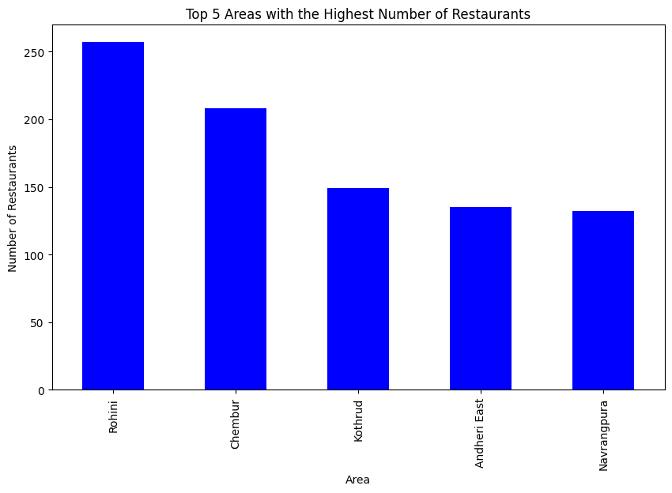
Highest count of Restaurants

Slide 5
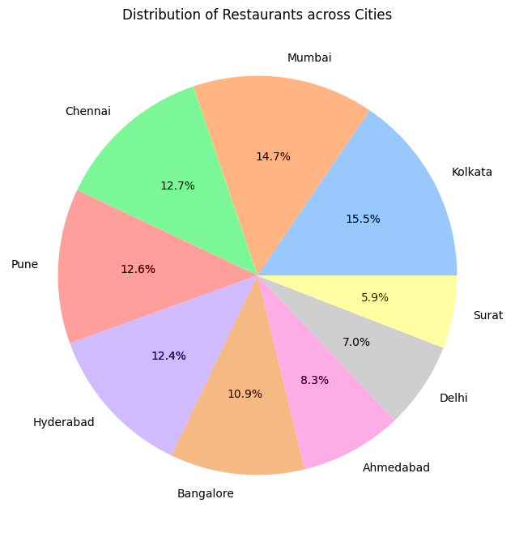
Restaurants across Cities

Slide 6
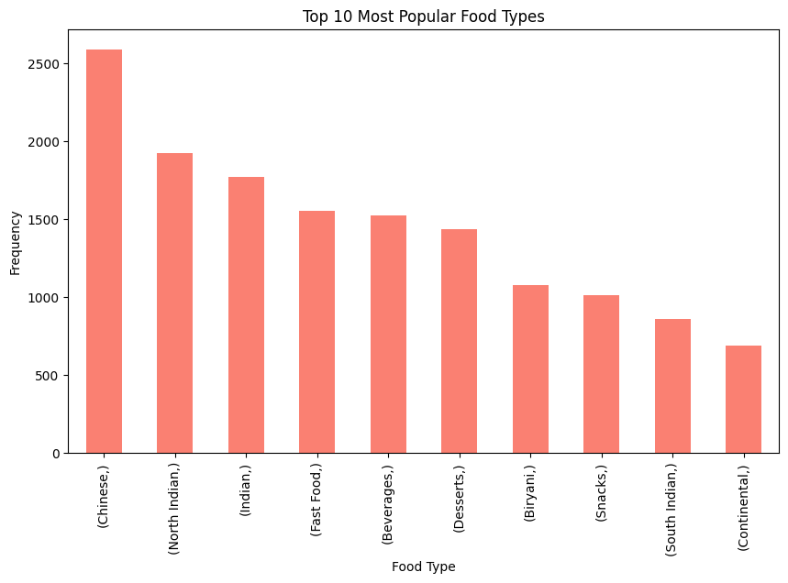
Top Cuisines

Slide 7
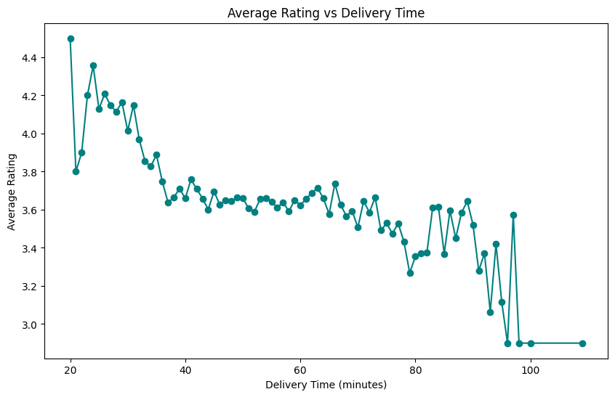
Ratings Analysis

Slide 8
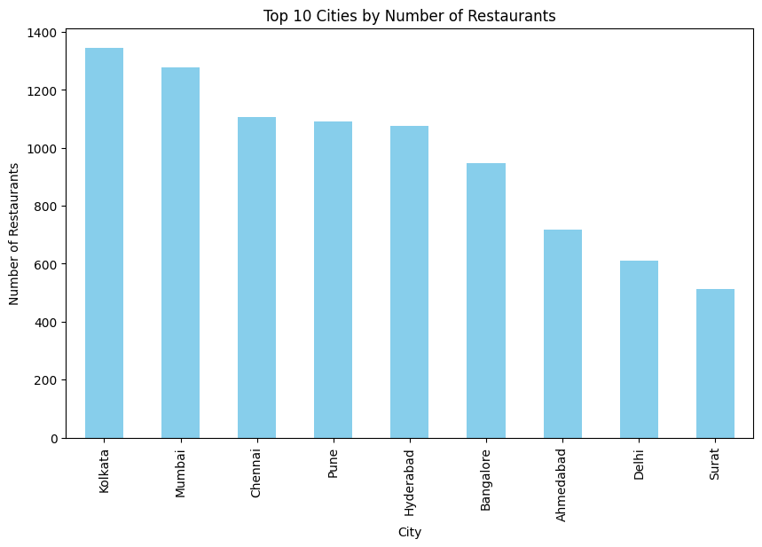
Top Cities by Count of Restaurants

Slide 9
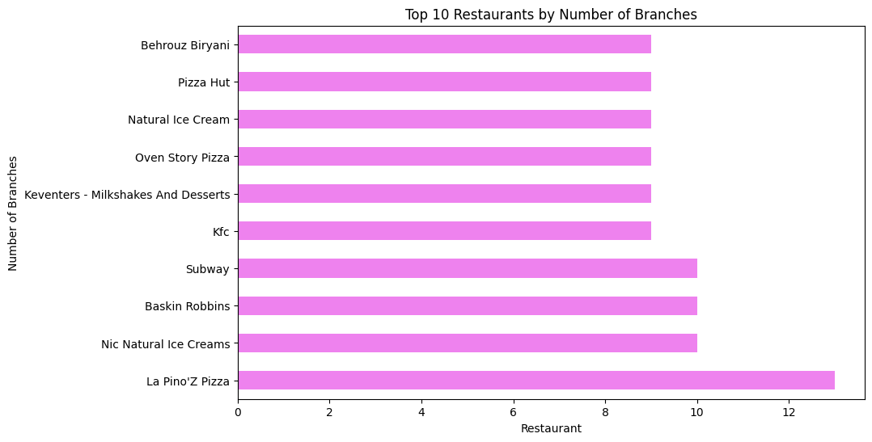
Top Restaurants (Branch count)

Slide 10
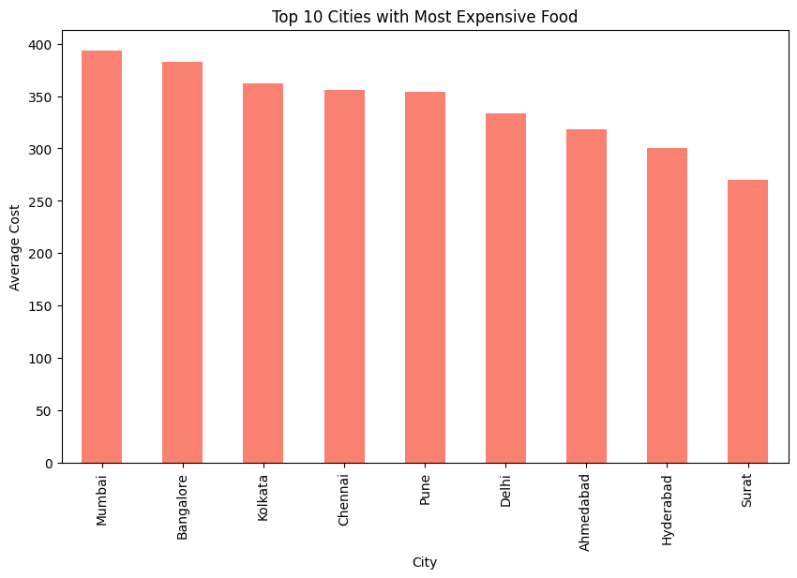
Expensive Food Distributions among Cities

Slide 11
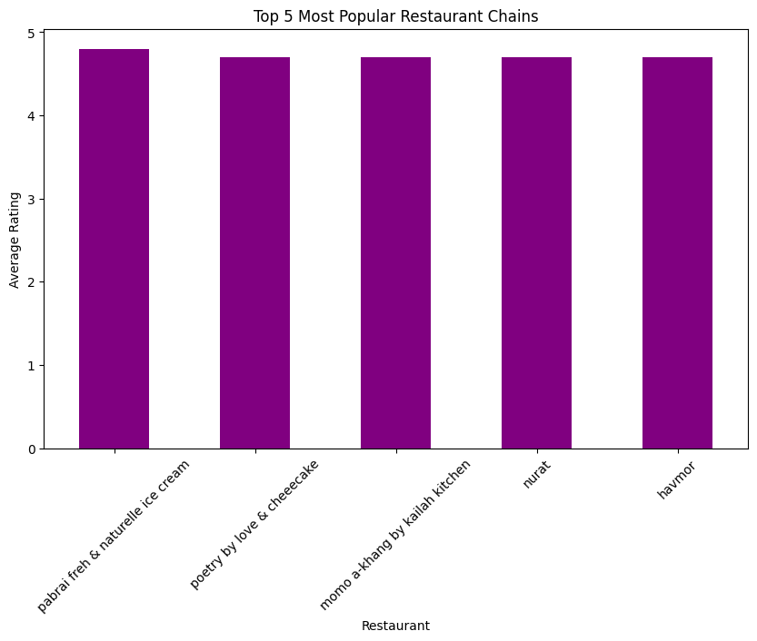
Popular Restaurant Chain

Slide 12


Slide 13
Recommendations
Consider opening new branches or strengthening presence in Rohini due to its high restaurant count.
Aim to deliver within 40 minutes to achieve higher customer satisfaction and ratings.
Focus on popular cuisines like Chinese and North Indian to attract a larger customer base.
Direct advertising campaigns towards cities with high restaurant density, such as Kolkata and Mumbai.
Promote well-known chains like La Pino'Z Pizza and Nic Natural Icecream to boost orders and visibility.

Slide 14
Conclusion
Rohini has the highest count of Top Restaurants, indicating a robust food scene.
Kolkata leads in the number of restaurants, suggesting a diverse culinary landscape.
Chinese cuisine is the most popular, while Continental cuisine is the least preferred.
Delivery time affects ratings, with the best ratings for deliveries under 40 minutes.
Mumbai is the city with the most expensive food distribution.
La Pino'Z Pizza is the most widespread Restaurant Chain.

Slide 15
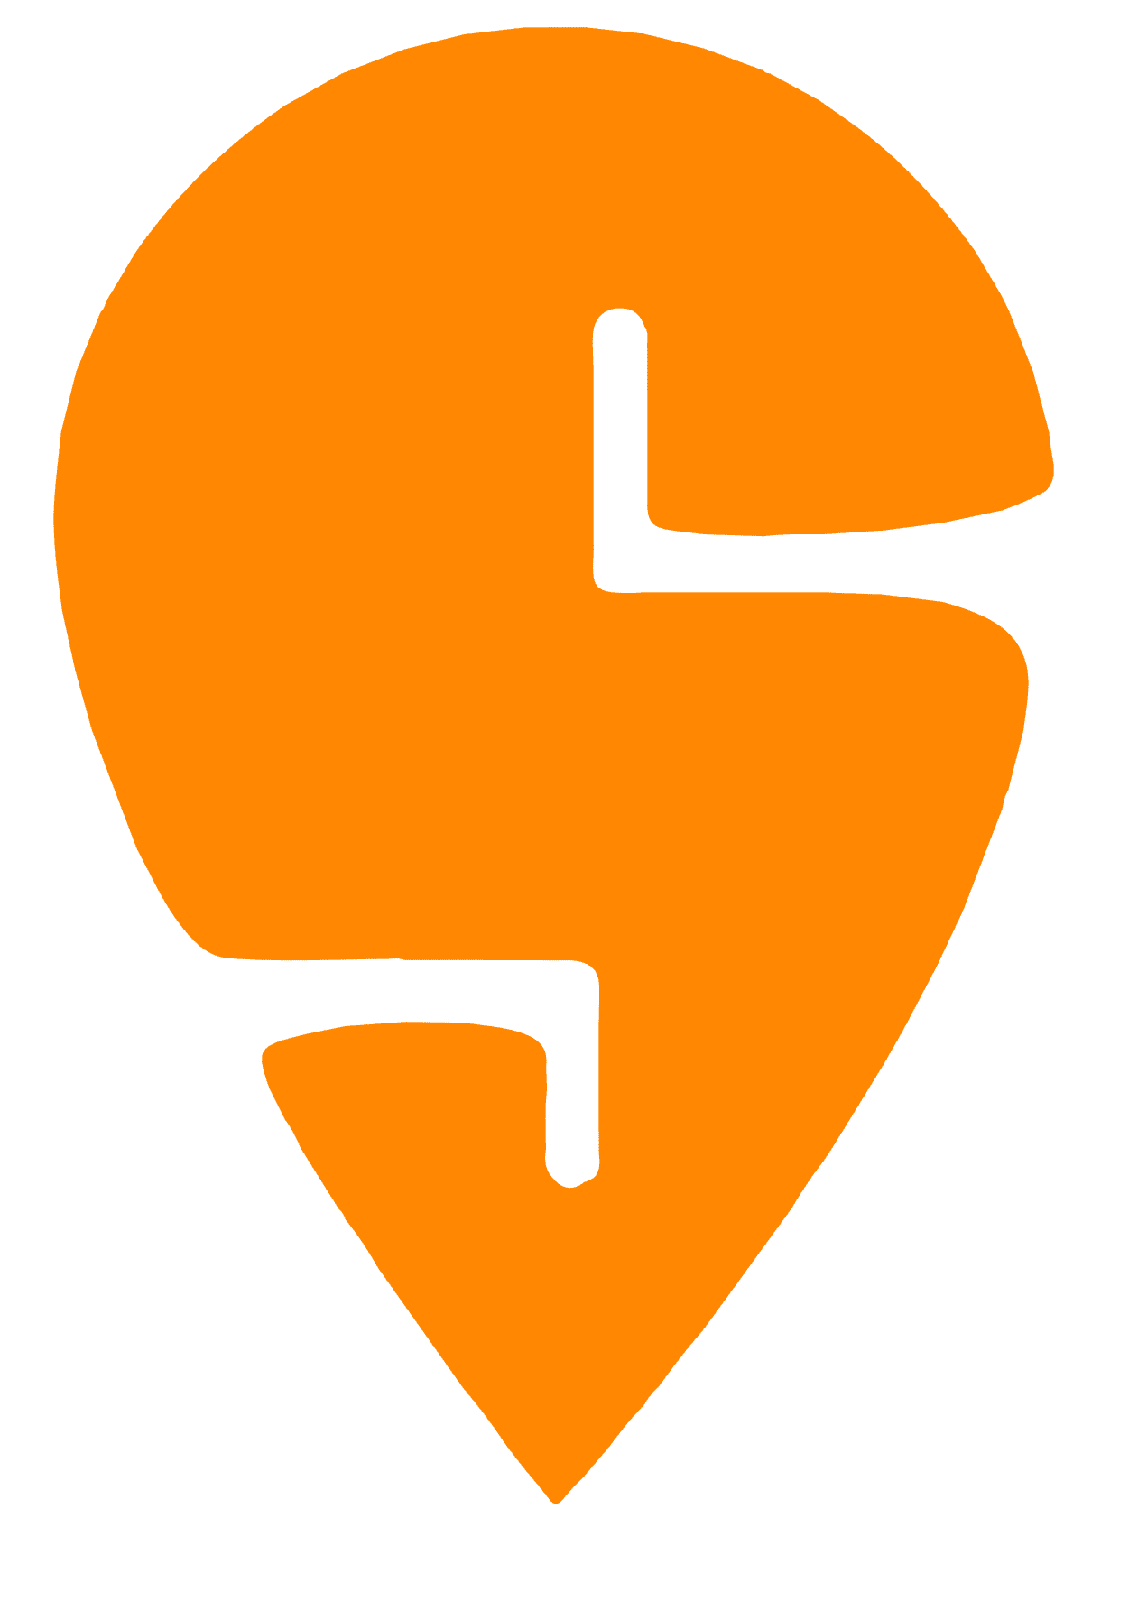
Thank You !
KARMUKILAN D K
Please keep this slide for attribution

